Slide 1
Generative AI in the Workforce
Team: GEN AI
Professor Rajamani
11/27/2024

Slide 2
Prompt #8:
New technology is now capable of communicating and making content in ways comparable to humans. It’s called generative artificial intelligence (AI), and you can use it to excel in the workforce. Generative AI can save you time, no matter what field you work in. It can create content for marketing, forecast numbers for finance, or code for software developers. Publicists can use it write press releases. Health professionals can even use it to improve their diagnosis.
We have been engaged by one of the largest think tanks to help propose policy suggestions to help minimize the potential negative impact on the jobs, industry and personal data.

Slide 3
Brief History / Background
Independence with Checkers - 1952
John McCarthy uses the term “Artificial Intelligence” - 1955
First chatbot using NLP - 1966
AI Boom- 1980 to 1987
AI Winter- 1987 to 1993
Regardless
Deep Blue beats Gary Kasparov - 1997
Apple Siri - 2011

Slide 4


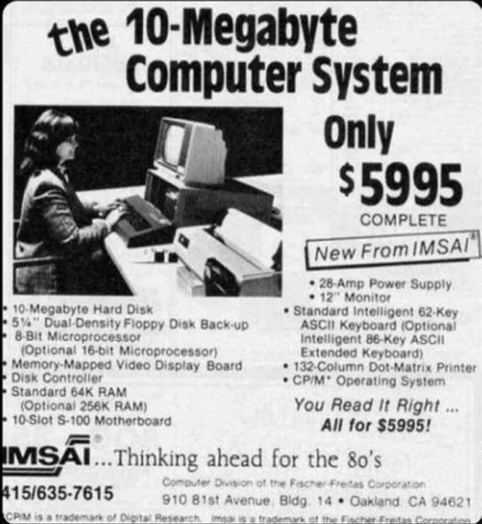
Currently
November 30, 2022
Million users in five days
100 million users in two months
Why?
Popularity grew overnight, not progress
Much better hardware

Slide 5
Cray-2 Supercomputer vs. iPhone 12
The iPhone 12 does x times as many floating point operations per second as a 1980’s supercomputer.
0.5
1
2
100
5000
Yes

Slide 6

Pros
More efficiency/increased productivity
More creativity
Can answer key questions
Cost Optimization

Slide 7
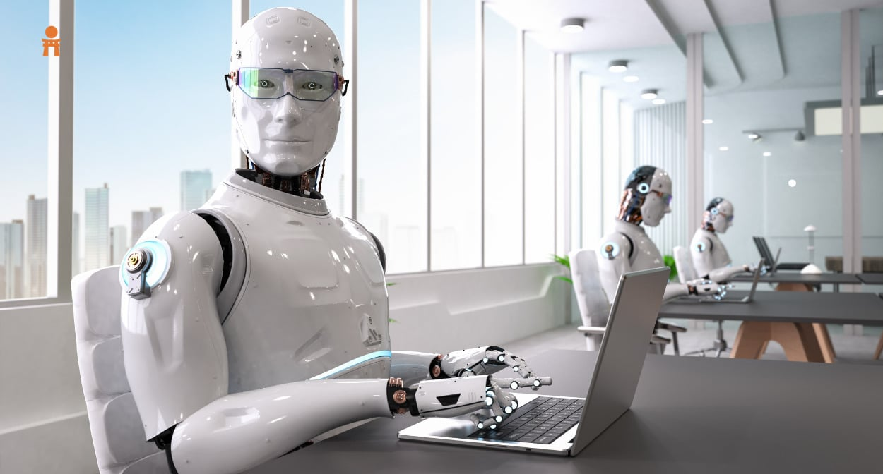
Cons
Job loss
Can become over reliant
Can be unethical
Security Risks

Slide 8

Policy Suggestions (ACM Code of Ethics)
Ensuring Fairness and Transparency (ACM Principle 1.4: Be Fair and Take Action Not to Discriminate)
Safeguarding Personal Data (ACM Principle 1.6: Respect Privacy)
Accountability for AI Decisions (ACM Principle 2.5: Give Comprehensive and Thorough Evaluations of Computer Systems and Their Impacts)
Supporting Workforce Transition (ACM Principle 2.1: Strive to Achieve High Quality in Professional Work)

Slide 9
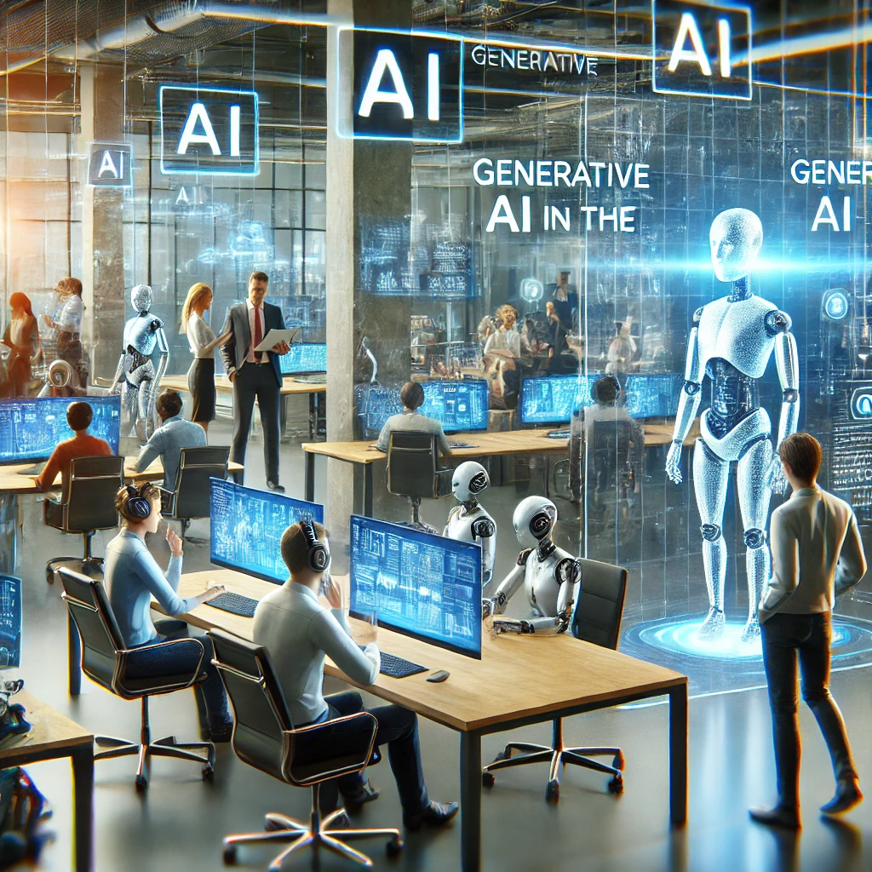
Conclusion
Revolutionizing Work
Generative AI enhances efficiency and creativity.
Examples: AI drafting marketing campaigns, analyzing medical data, creating movie visuals.
Frees up time for humans to focus on strategic and creative tasks.
Challenges We Must Address
Job displacement across industries.
Example: AI automating financial analysis, content creation, and customer service.
Ethical risks: Biased hiring algorithms, data privacy concerns, and accountability issues.
"AI is a powerful tool, but it requires thoughtful integration to ensure a fair and innovative future."

Slide 10

Call to Action
What We Must Do
Invest in AI Literacy
Learn AI-related skills to stay competitive.
Platforms: Coursera, LinkedIn Learning, Udemy.
Advocate for Responsible AI
Support clear policies and ethical frameworks.
Push for transparency in AI systems.
Collaborate with AI
Focus on what humans do best: creativity, empathy, and problem-solving.
Example: AI handling repetitive tasks while humans lead innovation.
Closing Statement: "Together, we can create a workforce where AI and humanity thrive in harmony." — Elena Carter, President of AI International Integration Committee

Slide 11
Works Cited
Hamirani, Q. “Here’s How Generative AI Will Redefine the Workplace.” Forbes, 15 Feb. 2024, www.forbes.com/sites/qhamirani/2024/02/15/heres-how-generative-ai-will-redefine-the-workplace/.
Shashkina, Victoria. “The Pros and Cons of Generative AI.” ITRex, 17 Nov. 2023, itrexgroup.com/blog/pros-and-cons-of-generative-ai/.
What is the history of Artificial Intelligence (AI)?. Tableau. (n.d.). https://www.tableau.com/data-insights/ai/history
Hu, K. (2023, February 2). CHATGPT sets record for fastest-growing user base - analyst note | reuters. Reuters. https://www.reuters.com/technology/chatgpt-sets-record-fastest-growing-user-base-analyst-note-2023-02-01/
Adobe Acrobat Team. (2022, November 8). Fast-forward - comparing a 1980s supercomputer to a modern smartphone: Adobe Blog. Adobe Blog. https://blog.adobe.com/en/publish/2022/11/08/fast-forward-comparing-1980s-supercomputer-to-modern-smartphone
The code affirms an obligation of computing professionals to use their skills for the benefit of society. Code of Ethics. (n.d.). https://www.acm.org/code-of-ethics

